Slide 1
Data Structure practical 3 and 4
PRESENTED BY
MR. N. K. S. YADAV

Slide 2
3. Selection Sort
Selection Sort is a sorting algorithm in which the smallest element is repeatedly selected from the unsorted part of the array and placed at the beginning.
In every pass:
The algorithm finds the minimum element
Swaps it with the first unsorted position
After each pass, the sorted portion of the array increases by one element.

Slide 3
example
Unsorted Array
7 4 9 2 5
Pass 1 Smallest element = 2
2 4 9 7 5
Pass 2 Smallest element = 4
2 4 9 7 5
Pass 3 Smallest element = 5
2 4 5 7 9
Pass 4
2 4 5 7 9
Array is sorted.

Slide 4
Algorithm
Start
Read number of elements
Input array elements
Set i = 0
Find the minimum element from index i to n-1
Swap it with element at position i
Increase i
Repeat steps until array is sorted
Display sorted array
Stop

Slide 5
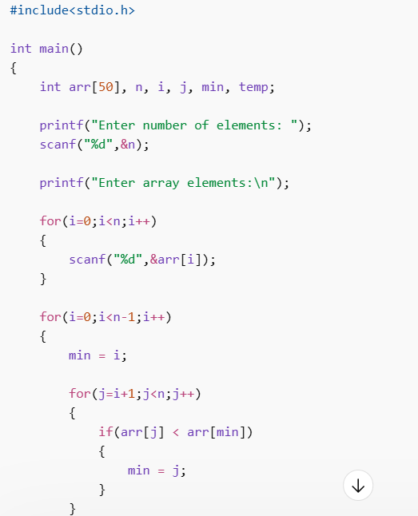
Selection sort C Program

Slide 6
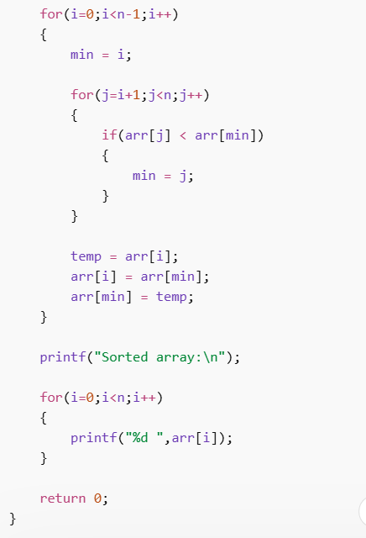
Selection sort C Program

Slide 7
Insertion Sort
Insertion Sort is a sorting algorithm that builds the final sorted array one element at a time.
It works the same way as arranging playing cards in hand:
Pick one element
Insert it into the correct position in the sorted portion.

Slide 8
Insertion Sort
Example
Unsorted Array
8 3 5 2
Step 1 First element is considered sorted.
8
Step 2 Insert 3 in correct position
3 8
Step 3 Insert 5
3 5 8
Step 4 Insert 2
2 3 5 8
Array is sorted

Slide 9
insertion Sort
Algorithm
Start
Read number of elements
Input array elements
Assume first element is sorted
Pick next element (key)
Compare it with previous elements
Shift larger elements to the right
Insert element at correct position
Repeat until array is sorted
Display sorted array
Stop

Slide 10
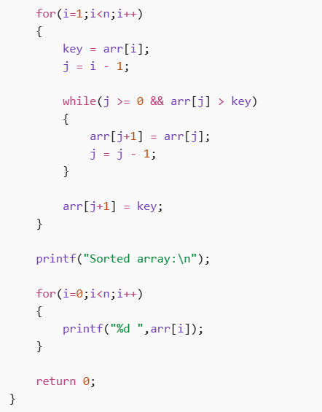
insertion Sort C Code

Slide 11
4. WAP to merge two arrays
Algorithm
Start
Declare three arrays arr1, arr2, and arr3
Read the size of the first array n1
Read elements of the first array
Read the size of the second array n2
Read elements of the second array
Copy elements of arr1 into arr3
Copy elements of arr2 into arr3 after arr1 elements
Display the merged array
Stop

Slide 12
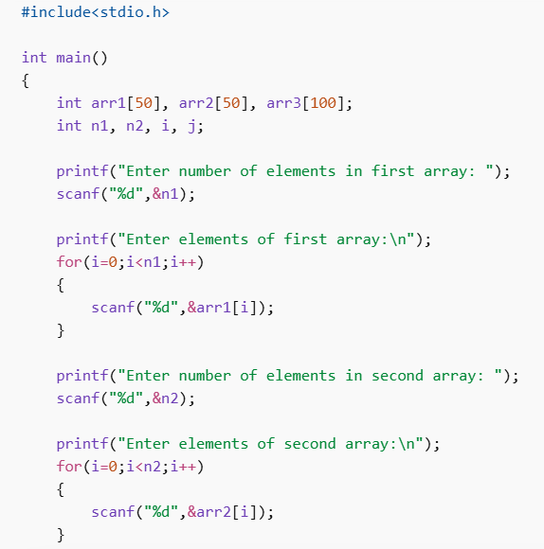
C code to merge two arrays

Slide 13
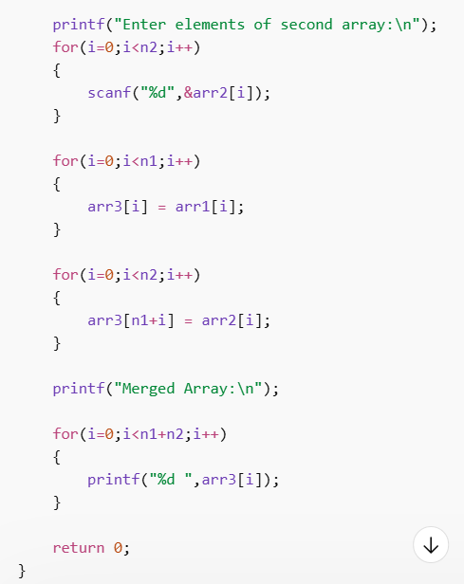
C code to merge two arrays

Slide 14
Thankyou!

